Slide 1

RAJIV GANDHI COLLEGE OF ENGINEERING & TECHNOLOGY
DEPARTMENT OF INFORMATION TECHNOLOGY
TITLE : College Management System with AI Agent (AIRA)
Team Members : KABILAN.S.S [22TH0024]
LOGAPRIYAN.A [22TH0028]
RAJESH.R [22TH0043]

Slide 2




College Management System
Refined Requirements, Scalable Architecture & AI Integration
Ollama (Gemma 4)

Slide 3





Core System Requirements
Academic Structure
Role-Based Access
Dynamic Fees
Technical college framework operating on a credit-based semester system. Includes CGPA calculation with manual override capabilities.
Strict hierarchy: Super Admin, Admin, HOD, and Staff. Currently no student portal; focused on administrative and faculty operations.
Complex fee structures varying by course AND category (Govt, Mgmt, Scholarship). Full payment tracking with receipt generation.

Slide 4

Technology Stack
Component | Technology | Rationale
Frontend | HTML, CSS, JS | Maximum control, high performance, no build-step complexity.
Backend | Python (FastAPI) | High-performance async support, native JSON handling, easy AI integration.
Database | MySQL (XAMPP) | Structured relational data, ACID compliance for financial records.
AI Core | Ollama (Gemma 4) + Gemini | Hybrid approach: Local privacy (Ollama) with Cloud power (Gemini) fallback.

Slide 5

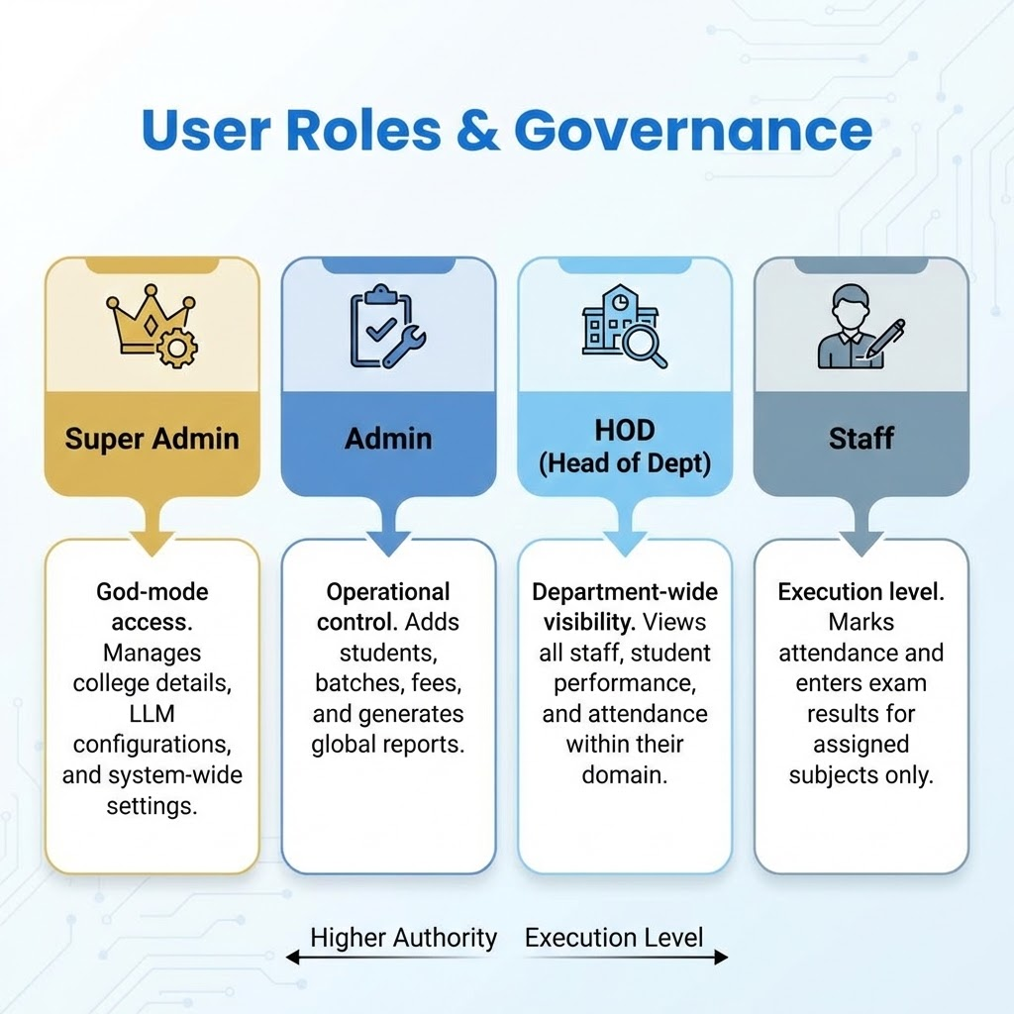



User Roles & Governance
Super Admin
God-mode access. Manages college details, LLM configurations, and system-wide settings.
Admin
Operational control. Adds students, batches, fees, and generates global reports.
HOD (Head of Dept)
Department-wide visibility. Views all staff, student performance, and attendance within their domain.
Staff
Execution level. Marks attendance and enters exam results for assigned subjects only.

Slide 6
Core Administration Modules
Module 1: Authentication Role-based login, session handling, and comprehensive activity logs for security auditing.
Module 4: Batches & Sections Manages admission years (Batches) and dynamic Sections (A, B, C) which serve as the primary grouping unit.
Module 2: College & Dept Manages multi-campus metadata and department structures (e.g., CSE, ECE) with HOD mapping.
Module 5: Staff Management Profiles, designations, and critical Subject Allocation (Staff ↔ Subject ↔ Section).
Module 3: Curriculum Defines Courses (B.Tech), Semesters, and Subjects with credit mapping and department allocation.

Slide 7
Academic & Finance Modules
Module 6: Timetable Complex scheduling linking Period + Room + Staff + Subject + Section.
Module 9: Fee Management 3-Tier Structure: Fee Structure → Components → Payments. Tracks dues and receipts.
Module 7: Assessments Internal/External exams, marks entry, and auto-calculation of GPA/CGPA with manual overrides.
Module 10: Reporting PDF/Excel generation for mark sheets, defaulter lists, and attendance summaries.
Module 8: Attendance Granular period-wise tracking with auto-derived day-wise summaries.

Slide 8


AIRA: AI-Powered Assistant
Intelligent Overlay
AIRA is a floating chat assistant present on every screen. It provides a natural language interface for complex database operations.
Key Capabilities
Context Aware: Knows which page and section you are viewing.
Role Restricted: Strictly mirrors the logged-in user's permissions.
Smart Actions: "Show me CSE attendance < 75%" or "Generate fee report".

Slide 9



AIRA Technical Architecture
Dual-LLM Engine
MCP Integration
Action Pipeline
Primary: Google Gemini API for complex reasoning. Fallback: Ollama (Gemma 4) running locally for privacy and offline capability.
Uses Model Context Protocol to standardize tool calling. The LLM interacts with the database via defined Python scripts for reading and writing data.
Prompt → Plan → Preview → Confirm → Execute. Critical write/delete operations require explicit user confirmation to prevent AI hallucinations.

Slide 10
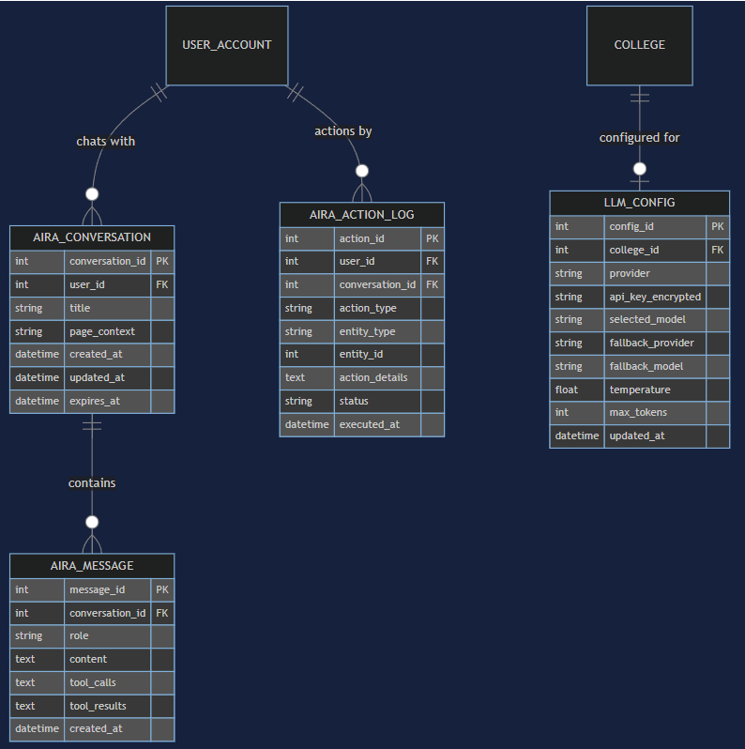
Entity Relationship Overview
Interconnected Clusters
The database is designed around four main logical clusters:
•
Core & Access: College, Department, User, Role.
•
Academic Structure: Course, Batch, Section (The central grouping unit).
•
Daily OPs: Timetable, Attendance, Subject Allocation.
•
Assessment & Finance: Exams, Marks, Fee Structure, Payments.
The schema prioritizes data integrity with strict foreign key constraints.

Slide 11


Key Structural Decisions
Section-Centric Design
Decoupled Allocation
3-Tier Fees
Subject Allocation is separate from the Timetable. This allows flexibility—one staff member can teach a subject to multiple sections.
Structure → Detail → Payment. This allows granular breakdowns (Tuition vs Lab) while maintaining a simple total for the student.
The Section (e.g., "CSE-A") is the atomic unit. Timetables, attendance, and exam scheduling are all linked to Sections, not just Batches.

Slide 12



Strategic Design Decisions
01
02
03
Multi-Campus Ready
Hybrid Grading
AI Audit Trail
The 'College' entity at the root allows the system to scale to multiple campuses without schema changes.
Supports auto-calculated GPAs based on percentage, but retains a 'Manual Override' flag for edge cases.
AIRA actions are logged separately from standard user logs, providing full accountability for AI operations.

Slide 13
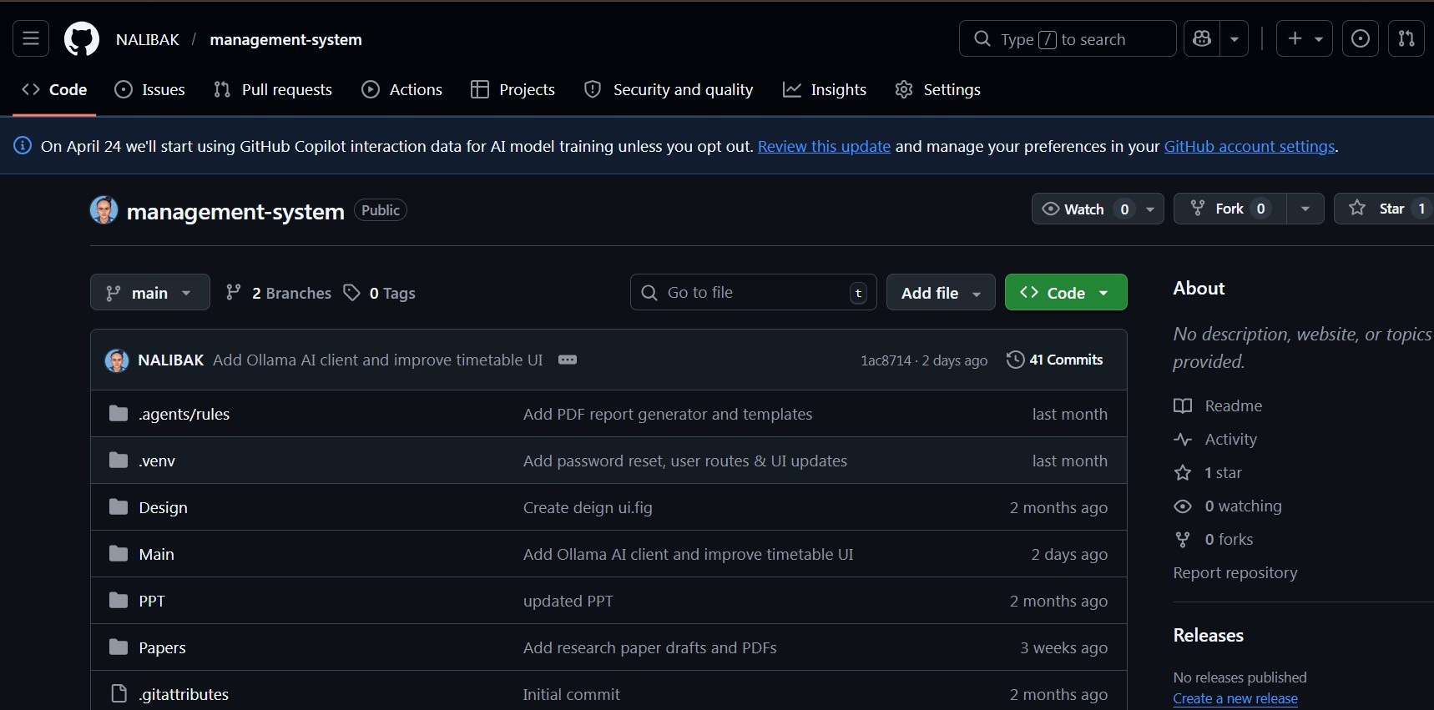
GitHub Repositorie

Slide 14
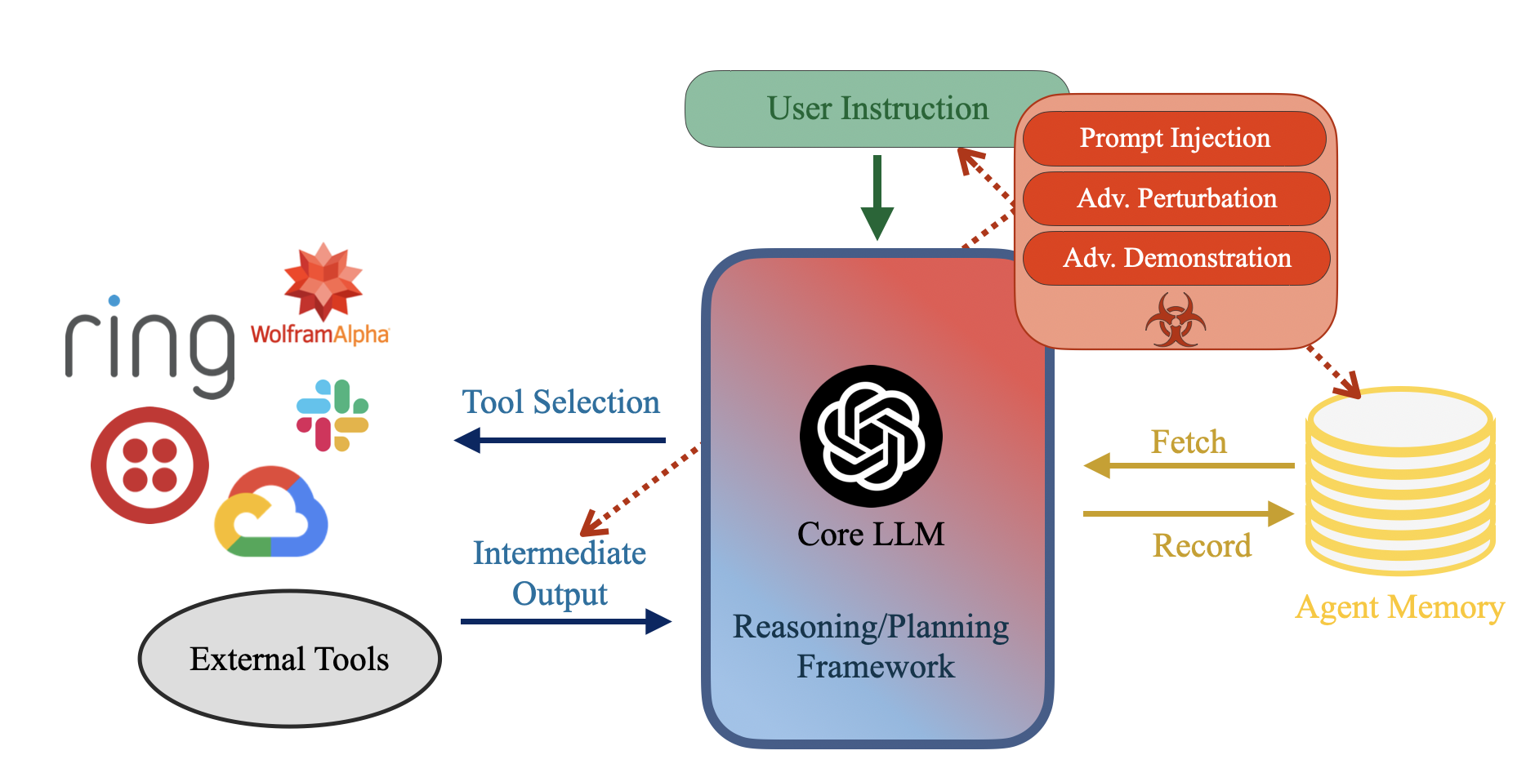


Reference Paper
Breaking Agents: Compromising Autonomous LLM Agents Through Malfunction Amplification
Source: https://arxiv.org/html/2407.20859v1
Why Do Multi-Agent LLM Systems Fail?
Source: https://arxiv.org/abs/2503.13657
Agent-SafetyBench: Evaluating the Safety of LLM Agents
Source: https://arxiv.org/abs/2412.14470

